Slide 1


2008 U.S. Economic Outlook and Current Conditions
  Paul D Fleming, CFP®, LIFA
  Senior Portfolio Manager
  Institutional Portfolio Management Services

Slide 2
2008 U.S. Economic Outlook and Current Conditions
  As we begin 2008, the following questions are yet unanswered:
    Is the U.S. in a recession?
    Will the defaults of subprime mortgage bonds continue to haunt the entire financial sector?
  The Risks
    Credit markets continue to contract (deflationary & recessionary).
    Commodity prices continue higher (inflationary & recessionary).
    Global policy errors – monetary, trade, regulatory, natural resource
    Unknown of US elections.

Slide 3
Positive developments over the last month:
    Fed became very aggressive in defending the economy by pushing its benchmark interest rate down to 3.00% - from 4.25% at the start of the year.
    Fed rate cuts will lower borrowing costs for auto and home equity loans, as well as many credit cards.
    Mortgage interest rates moved lower for qualified conventional loan borrowers, triggering a large number of refinances.
    Federal Government moved abnormally fast to pass a fiscal stimulus package.
    Having the Fed now focused on the economy is very important not only to Wall Street, but also to Main Street – and that is a good thing.
Items to watch:
  We do expect continued uncertainty and are looking for clues to the future trajectory of the economy via reports on:
    employment levels
    consumer spending
    news from the housing market.

Slide 4
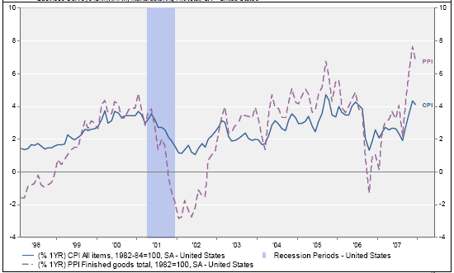
CPI and PPI Rising

Slide 5
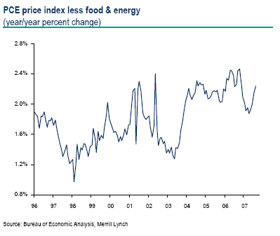
The Feds preferred measure of core inflation is rising after a dip early in the year.

Slide 6
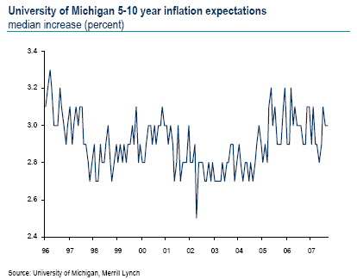
Consumer expectations for inflation remain contained.

Slide 7
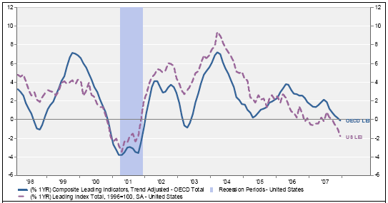
Leading Economic Indicators

Slide 8
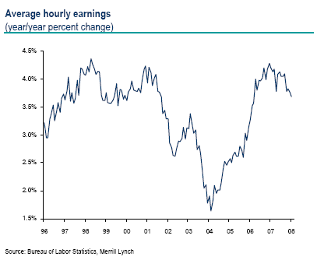
Average Hourly Earnings Year over Year

Slide 9
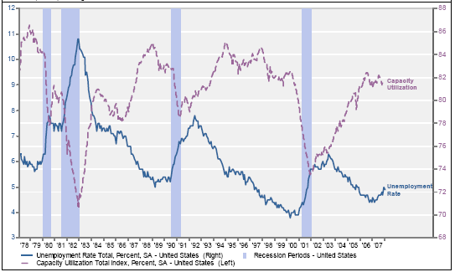
Unemployment and Capacity Utilization

Slide 10
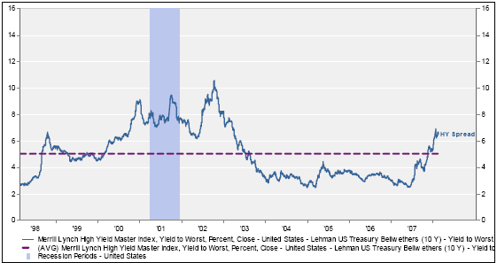
Bond Yield Spreads Increasing

Slide 11
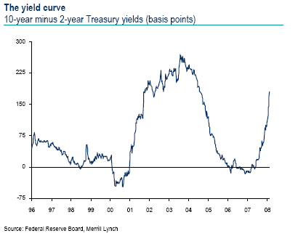

Slide 12
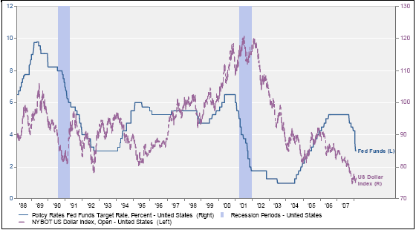

Slide 13
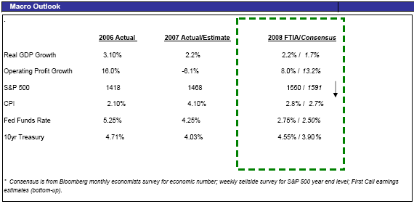

Slide 14
Summary
Optimistic Views
2007 finished with an annual growth rate GDP 2.2%.
Fed aggressively lowering Federal Funds Rate, currently 3.0%, down from 5.35%.
Unemployment rate and Treasury yields remain below 5%.
Export growth continues to expand, mortgage refinancing picked up in January.
Pessimistic Views
Negative job growth for the first time in 4 years.
Credit market issues continue to be uncovered.
Crude oil trading around $100 per barrel.
Recession Watch – from concerns about the housing and credit market disruptions on the real economy.

